Slide 1
CHAPTER 1:
A DAY IN THE LIFE OF
YOUR JEANS
USING OUR STUFF TO
DISCOVER SOCIOLOGY
© 2017 Taylor & Francis

Slide 2
Sociological imagination
 | Connects personal issues to larger social structures and historical context. • I shop too much because marketing makes clear that wearing fashionable clothes is a norm of consumer culture. • An immigrant may wear jeans in order to fit into her new country. • Many cotton farmers cannot survive on their production and are exposed to harmful chemicals.
© 2017 Taylor & Francis

Slide 3
Sociological imagination (continued)
 | Without it, we tend to reduce our private issues to personal failings and foibles. • I shop too much because I love new stuff.
 | Sociological imagination does not deny that individual choice exists, but asks how larger social forces shape individual lives. Idea conceived by C. Wright Mills.
© 2017 Taylor & Francis

Slide 4
Social structure
 | Enduring patterns in the organization of social life. • Capitalism, global commodity chains, gender inequality. Social structure includes institutions: states, markets and bureaucracies. Relatively fixed (stable). • Inequality between cotton and jeans producers, and corporations that distribute them.
 | However, constructed by human actions, therefore may be changed. • Anti-sweatshop activism and public pressure on major jeans brands to ensure acceptable working conditions.
© 2017 Taylor & Francis

Slide 5

Consumer culture
 | A historical type of society in which necessities are procured as commodities in the marketplace. Connected with capitalism. • Fashion cycles ensure profitability of jeans making.
© 2017 Taylor & Francis

Slide 6
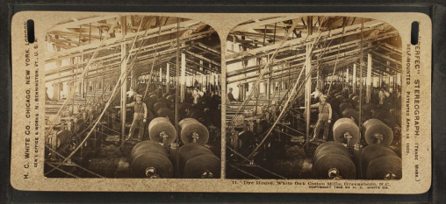
Consumer culture (continued)
Relatively "fun," expressive dimensions of consumer culture are enmeshed in serious social problems.
 | • Are your jeans just right for "you"? • Shopping with friends? • Who has made your jeans? • Do they make a comfortable living at it? • What environmental damage and risks were incurred to make your jeans?
© 2017 Taylor & Francis

Slide 7
Conspicuous consumption and
subsistence economy
Veblen: conspicuous consumption of luxury goods to signal elite status. • Top speed of a Porsche GT is 250 mph = 400 kph. • The highest speed limit in North America is 85 mph = 135 kph. Subsistence economy: people make necessities they use. • Would like to drive a Porsche? • Why? • Do you make or buy your clothes? • Are there any items in your residence made by yourself or your family members, neighbors and friends?
© 2017 Taylor & Francis

Slide 8
Capitalism
 | An economic system that originated in the sixteenth century Britain.
 | Characteristics: 1. private ownership over means of production and subsistence; 2. wage labor as a means of providing necessities for oneself; 3. dominance of market as a mechanism of distributing goods i.e. mass consumption; 4. orientation on profit; 5. orientation on growth. Without growth, crises.
© 2017 Taylor & Francis

Slide 9
Globalization
 | Social, political, economic and cultural processes that increasingly interconnect people, places, and economies throughout the world. • Period since the 1970s. Unequal benefits and disadvantages within and between societies.
 | The middle class and the global consumer culture: apparently similar, but unequal consumption habits.
 | • What does a meal at McDonald’s mean to Americans and Asians, respectively?
© 2017 Taylor & Francis

Slide 10
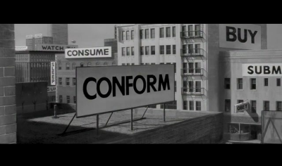
Capitalism and development of
sociology
 | Marx: critical of inequalities between workers (the proletariat) and owners (the bourgeoisie), and of the exploitation of workers.
• Durkheim: how do large-scale, industrialized, urban societies hold together without the bonds of tradition?
© 2017 Taylor & Francis

Slide 11
Development of sociology
(continued)
 | Weber: bureaucracy makes industrialized societies efficient, but it also dehumanizes experiences of their members. Martineau: campaigned for women’s rights and advocated inclusion of the perspectives of marginalized groups in research.
© 2017 Taylor & Francis

Slide 12
Sociological thinking frames:
material and cultural
 | Social life is both material and cultural. We cannot fully understand society without understanding both its material and cultural dimensions, and the way they intersect.
 | Culture is rooted in specific social, historical and material contexts.
 | • When and how have jeans changed from working men’s wear to leisure wear? • When and why have jeans become respectable, even luxurious?
© 2017 Taylor & Francis

Slide 13
Sociological thinking frames:
structure and agency
 | Agency: ability of individuals to make decisions and take actions. All actors have some agency, but one’s degree of autonomy in the face of structural constraints is shaped by one’s social location.
© 2017 Taylor & Francis

Slide 14
Social location
 | Individual or group position in a variety of social relations. It influences: 1. one’s identity; 2. others’ view of one; and 3. opportunities available to one.
 | • How much agency do you have within your family? • As a student? • At work?
© 2017 Taylor & Francis

Slide 15
Sociological thinking frames: micro
and macro
Scopes and levels of analysis in sociological research.
 | Micro: social interaction face-to-face and in small groups; meaning-making in these interactions. |  | Macro: social processes in large collectivities, at the institutional, national, and global levels.
 | • Do you and your friends wear the same brand of jeans?Why? • Why are so few jeans—originally an American clothing item—now made in the U.S.?
 | Deeply intertwined, both must be examined to understand society
© 2017 Taylor & Francis

